Slide 1
Lecture 4 Optimization for Machine Learning
Instructor: Lei Li, Yu-Xiang Wang

Slide 2
Recap: Supervised learning
Data
Hypothesis from
Loss function
Example:
Linear regression
Linear classifiers
Decision tree classifiers

Slide 3
Recap: Unsupervised learning
Data
Hypothesis
Loss function
Examples:
k-means clustering
PCA

Slide 4
Recap: Risk, Empirical Risk
Loss function
Risk function
Empirical risk

Slide 5
Recap: “One algorithm that rules them all” --- Empirical Risk Minimization
ERM
Regularized ERM

Slide 6
This lecture
Risk bound for general bounded loss functions
Model selection
Optimization methods for machine learning

Slide 7
Recap: Theorem for (fixed design) linear regression
Theorem: Assume (A1) and (A2), the ordinary least square estimator for linear regression satisfies:
Observations:
No assumptions on the design matrix X
The bound is exactly tight:
Recall that
When X = I,

Slide 8
The result relies on strong assumptions on how the data is generated
e.g., it does NOT apply to the case for fitting a polynomial to a noisy sine function we gave earlier!
The statistical learning problem:
Assumption B1: iid samples
Assumption B2: Bounded loss function
Assumption B3: Finite hypothesis class
Notes:
B2 and B3 are not needed in general…

Slide 9
The goal again is to bound the excess risk . This time we want a high probability bound.
With probability at least
Parameterize as a function of
Number of data points
Size of the hypothesis class
Boundedness of the loss
Failure probability

Slide 10
Introducing two powerful “hammers”: Hammer 1. Hoeffding’s inequality
(see Appendix D.1 of FML textbook for a proof)
Roughly saying that the empirical averages of independent random variable converges to the mean at a O(1/sqrt(n)) rate, with high probability.

Slide 11
Introducing two powerful “hammers”: Hammer 2. Union bound
Lemma (Union bound): For any probability distribution and any event E1, E2:

Slide 12
Now let’s apply these two hammers to solve statistical learning
For each hypothesis h, apply Hoeffding’s inequality
Union bound over all hypothesis

Slide 13
Now let’s apply these two hammers to solve statistical learning
Theorem: Assume (B1),(B2) and (B3), with probability at least
(over the distribution of the data), ERM satisfies

Slide 14
Quiz 2: Application to decision tree classifier
d-dimensional discrete feature ( L-levels for each)
H-layer decision tree, binary decision in one layer
K Labels
Upper bound of the size of hypothesis class?

Slide 15
Quiz 3: Application to generic classification (no restriction on the hypothesis class)
d-dimensional discrete feature ( L-levels for each)
K labels
Total number of unique classifiers?

Slide 16
Computation-approximation tradeoff in the choice of hypothesis class
 | model | Linear learners | Neural networks
Computation | Depends on how complex p* is | Efficient | Not efficient in the worst case, but…
Approximation | No approximation | Large approx. error | Small approx. error
Statistical efficiency | Depends on how complex p* is | Need less data | Need more data

Slide 17
“All models are wrong, but some are useful.”
George Box
(1919 - 2013)

Slide 18
Checkpoint: Theory of learning
Risk bounds for linear regression model
Risk bounds for a general learning problem with bounded loss
Observations:
Not directly comparable for several reasons
Strong assumption => Strong results
Weak assumption => Weak results
Notes:
R(\hat{h}) - R(h^*) = O\left(\sqrt{ \frac{\log|\mathcal(H)| + \log(1/\delta)}{n} }\right)

Slide 19
This lecture
Risk bound for general bounded loss functions
Model selection
Optimization methods for machine learning

Slide 20
Typical problems in model selection
Choose hypothesis class
Decision tree? Linear classifier? Or neural networks?
Choose hyperparameters
Depth of decision tree
Regularization weights for Ridge / Lasso
Choose which set of features of include

Slide 21
Model selection is challenging because we do not observe the actual risk!
Empirical risk is often a poor surrogate due to the optimization bias
Example: 1-Nearest Neighbor classifier
Two ideas for estimating the risk
Calculate or bound the actual risk in theory
Simulate the actual risk on a dataset not used for training.

Slide 22
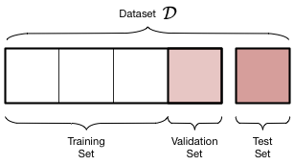
Empirically measuring the Risk by splitting the data into: Training, Test, and Validation Sets
Validation set is used for model-selection:
choosing decision tree vs. linear classifier
Select features, tune hyperparameters
Test set is used only once to report the final results.

Slide 23
Cross-validation
Pros:
No assumption on the data generating distributions, except iid.
Do not waste data, comparing to holdout.
Cons:
It evaluates the model applying to (S-1)/S fraction of the data
Computation cost = O(S * number of models to select from)

Slide 24
Other approaches for model selection
AIC (Akaike Information Criteria) / BIC (Bayesian information criteria)
(see PRML Section 1.3 and 4.4.1)
Effective degree of freedom
Measuring the effective number of parameters
For fixed-design regression with square loss + Gaussian noise, any estimator:
So if one can estimate df, then can use it for model selection

Slide 25
Effective degree of freedom for Regularized Linear Regression
Ridge regression
Number of parameters, if no regularization
Independent to data y, can be computed ahead of time
Lasso
Expected number of non-zero weights -- Sparsity.
This is truly remarkable that we get this via L1-regularization
See e.g. : https://www.stat.cmu.edu/~ryantibs/papers/lassodf.pdf

Slide 26
Checkpoint: model selection
Three approaches for model selection
Holdout
Cross validation
Penalize information criteria
Cross validation is what is most commonly used in practice.

Slide 27
Remainder of this lecture
Risk bound for general bounded loss functions
Model selection
Optimization methods for machine learning

Slide 28
How do we solve ERM?
Modeling
- Feature engineering
- Specify a family of classifiers
Inference
Learning
Apply the classifier to emails
Learning the best performing classifier

Slide 29
Recap: Linear classifiers
Score(x) = w₀ + w₁ * 1(hyperlinks) + w₂ * 1(contact list) + w₃ * misspelling + w₄ * length
A linear classifier: h(x) = 1 if Score(x) > 0 and 0 otherwise.
Question: What are the “free-parameters” in a linear classifier?
If we redefine
A compact representation:

Slide 30
Recap: Geometric view: Linear classifier are “half-spaces”!
{ x | w₀ + w₁ * x1+ w₂ * x2 + w₃ * x3 + w₄ * x4 > 0}
The set of all ”emails” that will be classified as “Spams”.
Non-spam
Proportion
of misspelled
words
spam
Length of the message

Slide 31
In the case when the training data is linearly separable, there is a polynomial time algorithm.
Why?
Easiest way to see it is that it is a linear program.
Polynomial time algorithm exists for all LPs.
Also, check out the Rosenblatt (1958)’s Perceptron algorithm from PRML 4.1.7, as well as its “mistake” bound analysis in FML-8.3.1.
Notes:
&\text{find }w \in \mathbb{R}^d\\
&\text{subject to:}\\
&\quad w^Tx_i > 0 \;\forall i\in\{1,2,...,n\}\; \text{s.t.} y_i = 1\\
& \quad w^Tx_i \leq 0 \; \forall
i \in\{1,2,...,n\} \;\text{s.t.} y_i = -1

Slide 32
Best linear separator in general (linearly non-separable cases) is NP-hard.
Non-spam
Proportion
of misspelled
words
spam
Length of the message

Slide 33
Just “relax”: relaxing a hard problem into an easier one

Slide 34
Why are “surrogate losses” easier to minimize?
They are continuous.
Differentiable (except hinge loss).
Convex.

Slide 35
Convex vs Nonconvex optimization
* Be careful: The surrogate loss being convex does not imply all ML problems using surrogate losses are convex. Linear classifiers are, but non-linear classifiers are usually not. Take “convex optimization” to know more.

Slide 36
How do we optimize a continuously differentiable function in general?
The problem:
Let’s just optimize it anyway!
With gradient descent.
Assumption: The objective function is differentiable almost everywhere.

Slide 37
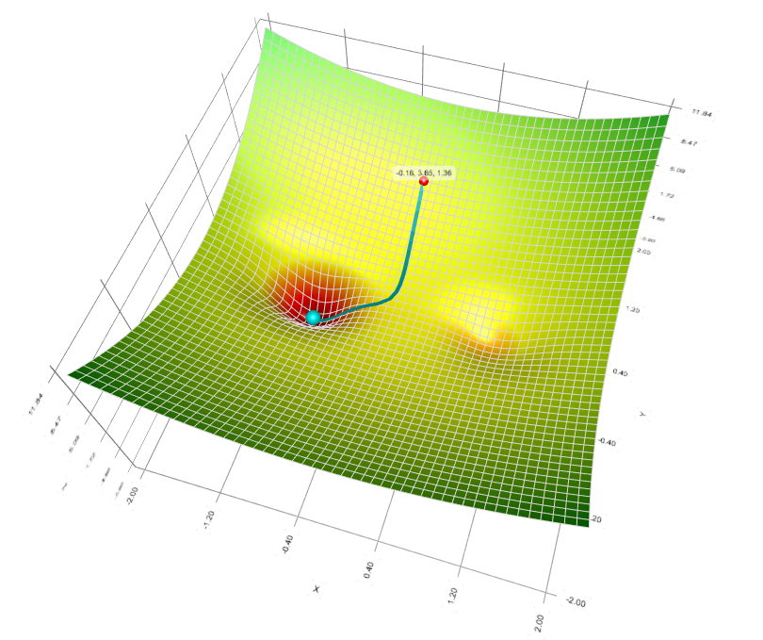
Gradient Descent Demo
Play with this excellent tool yourself to build intuition:
https://github.com/lilipads/gradient_descent_viz

Slide 38
Gradient of logistic loss for learning a linear classifier
The function to minimize is
How to calculate the gradient?
Take out a piece of paper and work on it!
(you have 3 min)
Hint:
Apply the chain rule.
d log(x) / dx = 1/x
d exp(x) / dx = exp(x)
Notes:
\min_{w\in\mathbb{R}^d} \frac{1}{n} \sum_{i=1}^n\log(1 + \exp(-y_i \cdot x_i^Tw))

Slide 39
Gradient of logistic loss for learning a linear classifier
What is the time complexity of computing this gradient?
Answer: O(d n).
Notes:
\frac{1}{n} \sum_{i=1}^n\frac{\exp(- y_i \cdot x_i^T w)}{1 + \exp(- y_i \cdot x_i^T w)} (-y_i x_i^T)

Slide 40
Stochastic Gradient Descent (Robbins-Monro 1951)
Gradient descent
Stochastic gradient descent
Using a stochastic approximation of the gradient:
Herbert Robbins
1915 - 2001

Slide 41
One natural stochastic gradient to consider in machine learning
Recall that
Pick a single data point i uniformly at random
Use
Show that this is an unbiased estimator!

Slide 42
Illustration of GD vs SGD
Observation: With the time gradient descent taking one step.
SGD would have already moved many steps.

Slide 43
Intuition of the SGD algorithm on the “Spam Filter” example
Contains hyperlinks
Proportion of misspelled words
Score(x) = w₀ + w₁ * 1(hyperlinks) + w₂ * 1(contact list) + w₃ * misspelling + w₄ * length
Meaning of these weight?
The more positive, the more we think the feature is associated with Spam email.
The more negative, the less that we think the feature is associated with Spam email
1 | 0 | 0.0375 | 80
Whether the contact list
Length of the message

Slide 44
Intuition of the SGD algorithm on the “Spam Filter” example
Scalar > 0:
≈ 0 if the prediction is correct
≈ 1 otherwise
Vector of dimension d:
provides the direction of the gradient
If we receive an example [1, 0 , 0.0375, 80] like the one before.
And a label y = 1 saying that this is a spam.
How will the SGD update change the weight vector?
Then by moving w towards the negative gradient direction, we are changing the weight vector by increasing the weights. i.e., increasing the amount they contribute to the score function (if currently the classifier is making a mistake on this example)
Notes:
If you make a mistake, move the weight towards the direction such that you will be less likely to make the same mistake in the future.

Slide 45
Interpretation of Gradient Descent
Taylor approximation of the objective function:
Choose the next point by minimizing the expansion

Slide 46
Convergence analysis of GD for smooth & non-convex objective
Problem setting:
Assumption: f is L-smooth (but not necessarily convex)
How to measure success?
ε-stationary point:
Iteration complexity:
Algorithm

Slide 47
Convergence analysis of GD for smooth & non-convex objective
Descent lemma
Telescoping

Slide 48
Convergence analysis of SGD for smooth & non-convex objective
Expected Descent Lemma
Telescoping

Slide 49
What happens if we assume the objective function is convex?
One region of solutions, thus stronger goal possible:
A summary of results (in iteration complexity)
 | Convex + G-Lipschitz + Bounded domain | Convex + L-Smooth | μ-strongly convex + L-smooth
GD
SGD

Slide 50
How to choose the step sizes / learning rates in practice?
In practice:
Use cross-validation on a subsample of the data.
Fixed learning rate for SGD is usually fine.
If it diverges, decrease the learning rate.
If for extremely small learning rate, it still diverges, check if your gradient implementation is correct.

Slide 51
The power of SGD
Extremely general:
Specify an end-to-end differentiable score function, e.g., a complex neural network.
Beyond the context of machine learning
Extremely simple: a few lines of code.
Extremely scalable
Just a few pass of the data, no need to store the data
People are continuing to discover that many methods are special cases of SGD.

Slide 52
Gradient Boosting
Widely-used packages: Xgboost, LightGBM

Slide 53
Gradient Boosting
Choose your favorite loss function
Square loss, Huber loss, Cross-entropy, Hinge loss, etc.
Score function is a weighted sum of decision trees.
ERM amounts to solving

Slide 54
Gradient Boosting as a “Projected” SGD algorithm
with no restriction on f
Take the gradient with respect to the predictions of f
But f needs to be a linear combination of trees, so let’s use a tree to approximate the gradient
Update the current function by gradient descent:

Slide 55
Summary
Risk bound for general bounded loss functions
Hoeffding’s inequality + Union bound argument
Model selection
Optimization methods for machine learning
Gradient Descent
Stochastic Gradient Descent
Convergence analysis
Gradient boosting as gradient descent.

Slide 56
Upcoming next: More discriminative modeling
Thursday: Feedforward neural networks
Next Tuesday: Convolutional neural networks

